Slide 1
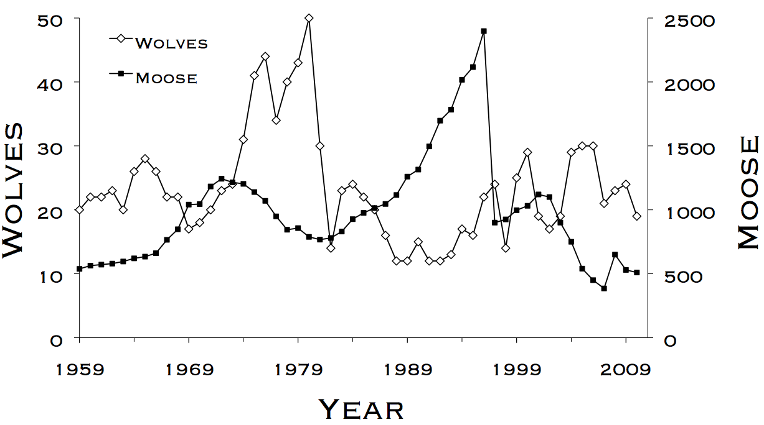
Lab 4 – Likelihoods and AIC
WLE 411, Week 8

Slide 2
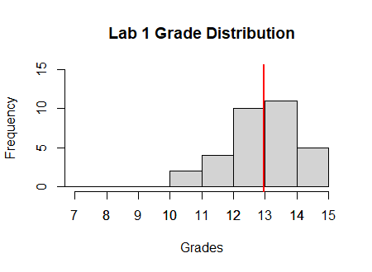
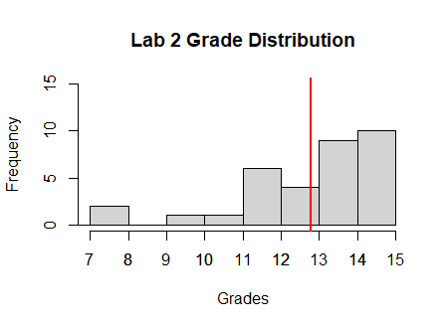
Mean: 13.0
Mean: 12.8
Excluding zeros
Notes:
More spread-out distribution (a few more high grades, a few more low ones)
Slow down!

Slide 3
Guidelines for submission
Submit assignments using one of the following formats:
Word document: .doc/.docx
Excel document: .xls/.xlsx
R script: .R (NOT .RProj)

Slide 4
Late penalties for partial assignments
Lots of partial submissions in the past two weeks
No unified policy
To ensure consistency in grading, we will follow this going forward:
Late penalty for the assignment is based on the day when the last portion of the assignment is turned in
Includes documents submitted in the wrong format

Slide 5
Bernoulli trials, or coin flips
3 out of 8 possible outcomes are 2H 1T
3H
2H 1T
2H 1T
1H 2T
2H 1T
1H 2T
1H 2T
3T
H
T
H
T
H
T
H
T
Coin flip 3
H
T
H
T
Coin flip 2
Let’s flip a coin 3 times.
How likely is it that we’ll get 2 heads and 1 tails?
H
T
Coin flip 1
Notes:
How many ways can we get a certain outcome?
2^3 = 8 possible outcomes

Slide 6
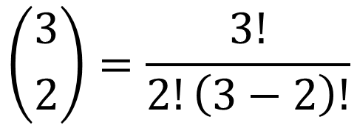
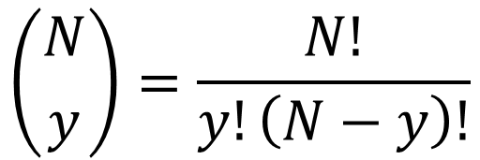
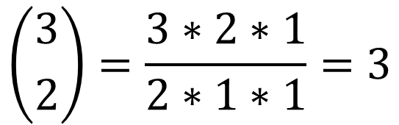
Number of successes in a Bernoulli trial
$$\left({N \atop y}\right)=\frac{N!}{y!\left(N−y\right)!}$$
We can get the same answer from this equation
N = number of trials
y = number of successes (heads)
$$\left({3 \atop 2}\right)=\frac{3!}{2!\left(3−2\right)!}$$
$$\left({3 \atop 2}\right)=\frac{3∗2∗1}{2∗1∗1}=3$$

Slide 7

Parameter likelihoods
Likelihood- the accumulated evidence for a certain parameter value or model
$$L(p|N,y)$$
translates to
The likelihood of a certain value of p assuming observed values of N and y
Notes:
Likelihoods are not probabilities- they are only useful when compared to each other
By comparing likelihoods from multiple values of p, we can see which value of p is most likely
We can also use likelihoods to compare different models

Slide 8

Likelihood can also be used to compare models
$$L(\hat{θ}|data)$$
translates to
The likelihood of a certain model assuming the observed data

Slide 9



Parsimony: think-pair-share
$$Model A:Survival \sim time$$
$$L(Model A|data)=0.2$$
$$Model B:Survival \sim time+age+sex$$
$$L(Model B|data)=0.2$$
Models A and B have identical likelihoods: which is the better model?

Slide 10

AIC uses likelihood for model selection
Penalty for # of parameters (parsimony)
$$AIC=−2\ln\left(L(\hat{θ}|data)\right)+2K$$
Likelihood of the model
The best model is the one with the smallest AIC

Slide 11
